Slide 1

Talkie - App Update
A language learning platform for all age to build real world fluency

Slide 2
Introduction
Talkie is a Mexico-based language learning platform that provides live, interactive English courses for children, teens, adults, and businesses. It helps learners build fluency and confidence through flexible online group .

Slide 3

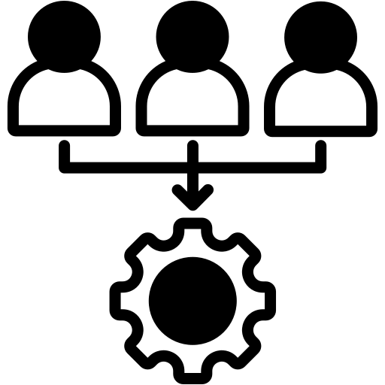

Platform Refresh & Alignment
Groups Integration
Notification System
Logo and Splash Screen Update
Update Contain: New Logo, New background colour, New images etc.
Platform groups will sync with app via API
Group shown in list or grid View
New message triggers push to all group members
Tapping redirects to that group’s chat at latest message
Note: The CometChat SDK will be used for chatting and notifications redirection

Slide 4
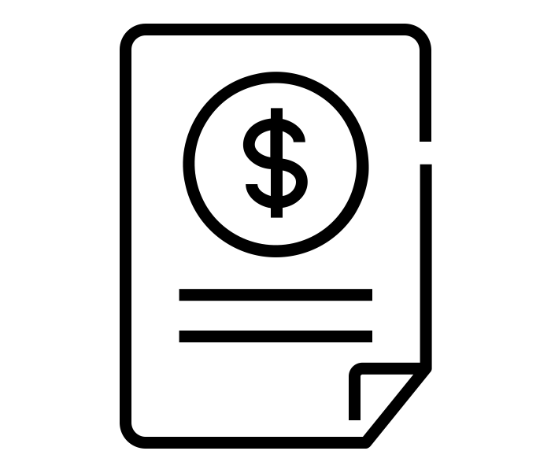
Project Costing
Costing
$ 2,000

Slide 5
Why Us – Expertise in Product & Domain
Product-led team, not just coders
Experience in building successful
SaaS Products
Start-Ups Idea to monetization model
Long term commitment and scalable delivery
Strong Governance & Communication Mode

Slide 6
Thank You

